Slide 1
Further Data Structures
Data Structures Week 9
The story so far
  Saw some fundamental operations as well as advanced operations on arrays, stacks, and queues
  Saw a dynamic data structure, the linked list, and its applications.
  Saw the hash table so that insert/delete/find can be supported efficiently.
  Saw trees and and applications to searching.
This week we will
  Introduce graphs as a data structure.
  Study operations on graphs including searching.

Slide 2
Introduction to Graphs
Data Structures Week 9
Consider the following problem.
A river with an island and bridges.
The problem is to see if there is a way to start from some landmass and using each bridge exactly once, return to the starting point.

Slide 3
Introduction to Graphs
Data Structures Week 9
The above problem dates back to the 17th century.
Several people used to try to solve it.
Euler showed that no solution exists for this problem.
Further, he exactly characterized when a solution exists.
By solving this problem, it is said that Euler started the study of graphs.

Slide 4
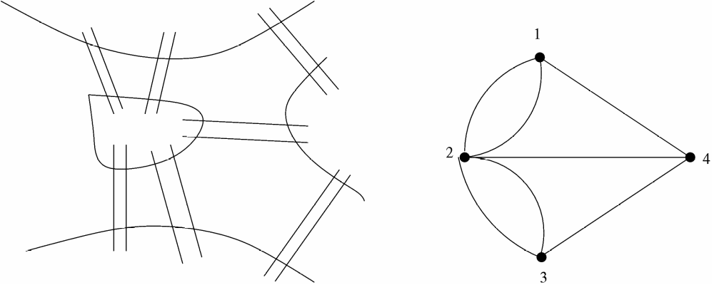
Introduction to Graphs
Data Structures Week 9
The figure on the right shows the same situation modeled as a graph.
There exist several such classical problems where graph theory has been used to arrive at elegant solutions.

Slide 5
Introduction to Graphs
Data Structures Week 9
Another such problem: In any set of at least six persons, there are either three mutual acquaintances or three mutual strangers.

Slide 6
Introduction to Graphs
Data Structures Week 9
Formally, let V be a set of points, also called as vertices.
Let E ⊆ VxV be a subset of the cross product of V with itself. Elements of E are also called as edges.
A graph can be seen as the tuple (V, E). Usually denoted by upper case letters G, H, etc.

Slide 7
Our Interest
Data Structures Week 9
Understand a few terms associated with graphs.
Study how to represent graphs in a computer program.
Study how traverse graphs.
Study mechanisms to find paths between vertices.
Spanning trees
And so on...

Slide 8
Few Terms
Data Structures Week 9
Recall that a graph G = (V, E) is a tuple with E being a subset of VxV.
Scope for several variations: for u, v in V
  Should we treat (u,v) as same as (v,u)?

Slide 9
Few Terms
Data Structures Week 9
Recall that a graph G = (V, E) is a tuple with E being a subset of VxV.
Scope for several variations: for u, v in V
  Should we treat (u,v) as same as (v,u)? In this case, the graph is called as a undirected graph.
  Treat (u,v) as different from (v,u).

Slide 10
Few Terms
Data Structures Week 9
Recall that a graph G = (V, E) is a tuple with E being a subset of VxV.
Scope for several variations: for u, v in V
  Should we treat (u,v) as same as (v,u)? In this case, the graph is called as a undirected graph.
  Treat (u,v) as different from (v,u). In this case, the graph is called as a directed graph.
  Should we allow (u,u) in E? Edges of this kind are called as self-loops.

Slide 11
Undirected Graphs
Data Structures Week 9
1
2
8
3
7
4
6
5
In this case, the edge (u,v) is same as the edge (v,u).
  Normally written as edge uv.

Slide 12
Undirected Graphs
Data Structures Week 9
The degree of a node v in a graph G = (V,E) is the number of its neighbours.
  It is denoted by d(v).
In the above example, the degree of vertex 4 is 4. The neighbors of vertex 4 are {3, 5, 6, 7}.
The degree of a graph G = (V,E) is the maximum degree of any node in the graph and is denoted G. Sometimes, written as just  when G is clear from the context.
  Thus,  = max_{v∈V} d(v).
  Thus  = 6 for the above graph.

Slide 13
Some Terms
Data Structures Week 9
In a graph G = (V,E), a path is a sequence of vertices v1, v2, · · · , vi, all distinct, such that v_{k}v_{k+1} ∈ E for 1 ≤ k ≤ i − 1.
If, under the above conditions, v1 = vi then it is called a cycle.
The length of such a path(cycle) is i − 1(resp. i).
An example: 3 – 8 – 5 – 2 in the above graph is a path from vertex 3 to vertex 2.
Similarly, 2 – 7 – 6 – 5 – 2 is a cycle.

Slide 14
Directed Graphs
Data Structures Week 9
1
2
3
4
6
5
In this case, the edge (u,v) is distinct from the edge (v,u).
  Normally written as edge 〈u, v〉.

Slide 15
Directed Graphs
Data Structures Week 9
Have to alter the definition of degree as
in-degree(v) : the number of neighbors w of v such that (w,v) in E.
out-degree(v) : the number of neighbors w of v such that (v,w) in E.
in-degree(4) = 1
out-degree(2) = 2.

Slide 16
Directed Graphs
Data Structures Week 9
Have to alter the definition of path and cycle to directed path and directed cycle.

Slide 17
Representing Graphs
Data Structures Week 9
How to represent graphs in a computer program.
Several ways possible.

Slide 18
Adjacency Matrix
Data Structures Week 9
The graph is represented by an n × n–matrix where n is the number of vertices.
Let the matrix be called A. Then the element A[i, j] is set to 1 if (i, j) ∈ E(G) and 0 otherwise, where 1 ≤ i, j ≤ n.
The space required is O(n²) for a graph on n vertices.
By far the simplest representation.
Many algorithms work very efficiently under this representation.

Slide 19
Adjacency Matrix Example
Data Structures Week 9
A
1 2 3 4 5 6
1
4
1
2
3
4
5
6
0
1
0
1
1
0
1
0
1
0
1
0
0
1
0
1
0
1
1
0
1
0
0
0
1
1
0
0
0
0
0
0
1
0
0
0
2
6
5
3

Slide 20
Adjacency Matrix Observations
Data Structures Week 9
Space required is n²
The matrix is symmetric and 0,1—valued.
  For directed graphs, the matrix need not be symmetric.
Easy to check for any u,v whether uv is an edge.
Most algorithms also take O(n²) time in this representation.
The following is an exception: The Celebrity Problem.

Slide 21
Adjacency List
Data Structures Week 9
Imagine a list for each vertex that will contain the list of neighbours of that vertex.
The space required will only be O(m).
However, one drawback is that it is difficult to check whether a particular pair (i, j) is an edge in the graph or not.

Slide 22
Adjacency List Example
Data Structures Week 9
1
2
3
4
5
6
2
5
4
1
4
5
1
3
2
6
2
6
4
6
1
3
5
3
1
2
3

Slide 23
Adjacency List
Data Structures Week 9
Useful representation for sparse graphs.
Extends to also directed graphs.

Slide 24
Other Representations
Data Structures Week 9
Neighbor maps

Slide 25
Searching Graphs
Data Structures Week 9
A fundamental problem in graphs. Also called as traversing a graph.
Need to visit every vertex.
Can understand several properties of a graph using a traversal.
Two main techniques : breadth first search, and depth first search.

Slide 26
Breadth First Search
Data Structures Week 9
Recall level order traversal of a tree.
  Starting from the root, visits every vertex in a level by level manner.
Let us develop breadth first search as an extension of breadth first search.

Slide 27
Breadth First Search
Data Structures Week 9
For a graph, no notion of a root vertex.
So, have to specify a starting vertex. Typically denoted s.
Still other problems exist.

Slide 28
Breadth First Search
Data Structures Week 9
In a tree, using level order traversal, each vertex is visited also exactly once.
  Why?

Slide 29
Breadth First Search
Data Structures Week 9
In a tree, using level order traversal, each vertex is visited also exactly once.
  Recall that a tree is connected and has no cycles.

Slide 30
Breadth First Search
Data Structures Week 9
In a tree, using level order traversal, each vertex is visited also exactly once.
  Recall that a tree is connected and has no cycles.
In a graph, that is no longer guaranteed.
  Start from s = 2.
1
2
5

Slide 31
Breadth First Search
Data Structures Week 9
In a tree, using level order traversal, each vertex is visited also exactly once.
  Recall that a tree is connected and has no cycles.
In a graph, that is no longer guaranteed.
  Start from s = 2.
  One of 1 or 5 visited more than once.
1
2
5

Slide 32
Breadth First Search
Data Structures Week 9
How to resolve that problem?
1
2
5

Slide 33
Breadth First Search
Data Structures Week 9
How to resolve that problem?
Can remember if a vertex is already visited.
Each vertex has a state among VISITED, NOT_VISITED, IN_PROGRESS.
Why three states instead of just two?
  Need them for a later use.
1
2
5

Slide 34
Breadth First Search
Data Structures Week 9
Another problem is with respect to some vertices that cannot be reached from s.
For example, when s = 2, vertex 3 can never be visited.
What to do with those vertices?
Answer depends on the idea behind graph searching via BFS.
1
3
2
5

Slide 35
Breadth First Search
Data Structures Week 9
The basic idea of breadth first search is to find the least number of edges between s and any other vertex in G.
  The same property holds for level order traversal of a tree also with s as the root.
Starting from s, we can thus visit vertices of distance k before visiting any vertex of distance k+1.
For that purpose, define d_{s}(v) to be the least number of edges between s and v in G.

Slide 36
Breadth First Search
Data Structures Week 9
So, for vertices v that are not reachable from s, can say that d_{s}(v) is ∞.
Alike a level order traversal of a tree, can use a queue to store vertices in progress.

Slide 37
BFS Procedure
Data Structures Week 9
Procedure BFS(G)‏
for each v ∈ V do
(v)= NIL;colour[v] = RED; d(v) = ∞;
End-for
d[s] = 0; colour[s] = YELLOW; [s]= NIL, Q = EMPTY; Q.Enqueue(s);
While Q is not empty do
v = Q.Dequeue();
for each neighbour w of v do
if colour[w] = RED then
colour[w] = YELLOW; [w] = v;
d[w] = d[v] + 1; Q.Enqueue(w);
end-if
colour[v] = GREEN
end-for
end-while

Slide 38
BFS Example
Data Structures Week 9
Start from s = 2.
1 2 3 4 5 6
1
4
d : ∞ 0 ∞ ∞ ∞ ∞
                   
2
6
6
5
3

Slide 39
BFS Example
Data Structures Week 9
Start from s = 2.
1 2 3 4 5 6
1
4
d : ∞ 0 ∞ ∞ ∞ ∞
                   
2
6
6
d : 1 0 1 ∞ 1 2
   2 - 2 - 2 3
d : 1 0 1 2 1 2
    2 - 2 1 2 3
5
3

Slide 40
BFS
Data Structures Week 9
The runtime of BFS is O(m+n)
  Each vertex enters the queue at most once.
  Each edge is considered only once.
The value of a vertex v denotes the vertex u that discovered v.
The  values maintained during BFS can be used to define a tree as follows.
Define the predecessor subgraph of G = (V,E) as
  G = (V,E) where
  V = {v ∈ V : (v) != NULL}  {s} and
  E = {((v), v) ∈ E : v ∈ V − {s}}.

Slide 41
BFS Example Contd...
Data Structures Week 9
1
4
2
6
5
3

Slide 42
Properties BFS
Data Structures Week 9
Notice that once color of a vertex v changes YELLOW, then d_{s}(v) can never change after that.
At that time, v has entered the queue.
Can classify edges of G according to BFS from a given s as follows.

Slide 43
Classifying Edges
Data Structures Week 9
The edges of E are also called as tree edges.
It holds that for a tree edge (u, v), d(v) = d(u) + 1.
The edges of E_{N} := E \ E are called as non-tree edges.
These edges can be further classified as follows.

Slide 44
Classifying Edges
Data Structures Week 9
An edge (u, v) ∈ E_{N} is called as a back edge if d_{s}(v) < d_{s}(u).
In other words, u can be reached from s via v, but there is yet another shortest path through path u can be reached from s.
An edge (u, v) ∈ E_{N} is called a cross edge if d(v) ≤ d(u) + 1.

Slide 45
Directed or Undirected
Data Structures Week 9
Most of the above observations hold even if G is directed.
Can thus extend the notion of BFS to directed graphs.

